Slide 1
Usability Testing & Healthcare Applications
Team 6: Cristina Hilario, Sean O’Connor and Rudolph Paulin

Slide 2
Our Scenario
The topmost priority of the North Carolina Department of Health and Human Services (the Department) is the health and well-being of the individuals they serve. Your team is assigned to work on the usability testing of a SAAS application targeted for healthcare systems to be used by the served population. Think through the target audience, discuss and present the test plan for ensuring better usability of the mobile and web app. Focus on what constitutes usability to the target audience, and how your proposal addresses those concerns.

Slide 3

What is SAAS
Form of SaaS: Cisco Webex Yahoo, Outlook, Hotmail, Netflix, etc.
Method of software delivery that allows data to be accessed from any device with an internet connection and a web browser.
Called sometimes: Web-based software, on-demand software, or hosted software.

Slide 4

SaaS and Healthcare Applications
Cloud based services leading to incredible advancements in the healthcare industry.
SaaS: Easier Collaboration, quick scalability and integration, ease of use.
SaaS model in the healthcare industry grows at a rate of 20% annually.
Cloud computing market in healthcare is predicted to reach $51.9 billion by 2024.

Slide 5
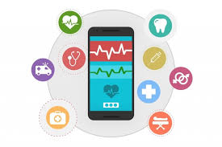
SaaS and Healthcare Applications
Healthcare app to improve quality of services and promote self management behaviors in patients.
Use of the apps to schedule an appointment, review prescriptions, connect to doctors, online diagnosis.
Majority of healthcare apps do not meet the users/patients expectations.

Slide 6


North Carolina Department of Health and Human Services
https://www.ncdhhs.gov/ NC Medicaid mobile app
The department delivers health and human related services for all North Carolinians, with emphasis on vulnerable citizens, such as children, elderly, disabled and low-income families.
Used to find and sign up for primary care providers (PCPs) and health plans
Gives directions to nearby providers, hospitals, specialists and more

Slide 7
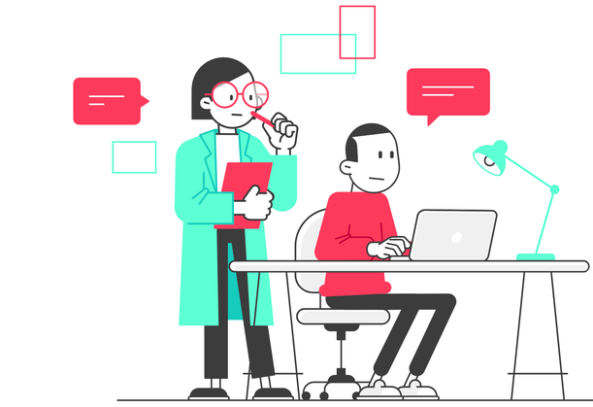
Usability Testing
Method of testing the functionality of a website, app or other digital product by observing real users as they attempt to complete tasks on it.
Basic features to be easily accessible to the end-users.
Interactive tools to keep users engaged.
Easy communication with healthcare professionals.
Community feature.
User friendly UI

Slide 8
Testing Plan
Objective: determine design inconsistencies and usability problem areas within the user interface & content areas
Find 5 participants who accurately represent the target audience
After each task, the participants fill out a post-task questionnaire
Note and categorize errors or design concerns
Task Observations: Completion Rate, Error-free rate, Time on Task, Subjective Measures
Problem Severity Classification:
Impact
Frequency
Notes:
https://www.usability.gov/how-to-and-tools/methods/planning-usability-testing.html

Slide 9
Error Classification
Impact
High - prevents the user from completing the task
Moderate - causes user difficulty but the task can be completed
Low - minor problems that do not significantly affect the task completion
Frequency
High - 30% or more
Moderate - 11% - 29%
Low - 10% or fewer
Problem Severity Classification
High impact problems that often prevent users from correctly completing a task
Moderately occurring problems with moderate to low impact
Low impact problems faced by few participants
Notes:
https://www.usability.gov/how-to-and-tools/methods/planning-usability-testing.html

Slide 10

Participant 01
Age: 27
Job: Video Editor
Location: Releigh
Status: Engaged
Income: $60,000
Behaviors:
Has very little time and drive to want and book and go to doctor’s appointments
Impatient when it comes to waiting in line
Julia
Team Manager
Bio: Julia loves her job as a video editor and has recently just received her first team management job for a small but impactful part of her companies next big contract.
This comes at a busy time for her as she has recently become engaged and together the two of them are planning their small wedding.
Technology History:
Microsoft Office Products
Video Editing Software
Various Smart Technologies
Virtual Banking Apps
Art Apps

Slide 11
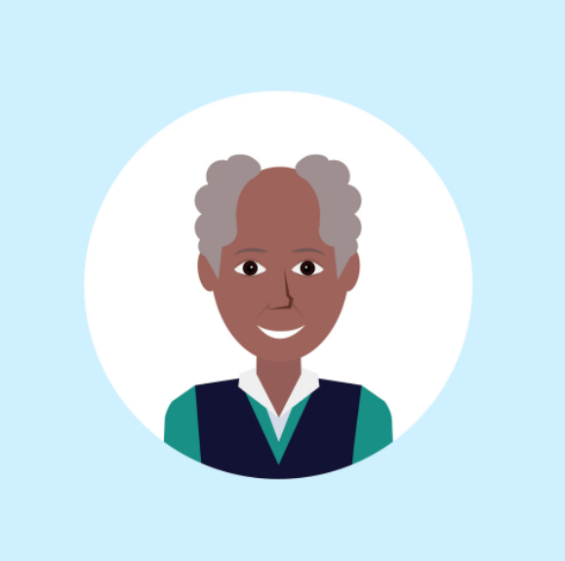
Participant 02
Age: 68
Job: Retired (was in Finance)
Location: Asheville
Status: Married, 1 Kid
Income: was $80,000
Behaviors:
Impatient when it comes to using his smartphone
Increases the size of the text on his phone and computer
Reggie
Retired
Bio: Reggie has recently retired from his career in the finance industry. He has been trying to take care of himself more recently so he can spend more time with his grandkids.
Reggie has never used a healthcare app on his phone before, and he does not know they even exist for his area.
Technology History:
Microsoft Office Products
Company Big Data Financial Software
First SmartPhone bought 7 years ago

Slide 12

Participant 03
Age: 36
Job: Human Resources
Location: Murphy
Status: Married, 3 Kids
Income: $45,000
Behaviors:
Speaks English as a second language
Values flexibility
Jennifer
Team Manager
Jennifer is a first generation college graduate who works as an HR recruiter. With the move to mostly online services Jennifer has been feeling pretty stressed with having to get her kids and mother all set up with online school and healthcare.
Jennifer’s mother’s health has been declining over the past couple of years and Jennifer within the last few months sold her mother’s condo and had her move in with her family. She also now takes responsibility for her mother’s doctors appointments and finances.
Technology History:
Google Products
Most social and professional media sites

Slide 13
Conclusion
In testing the app and website through the perspectives of our personas, we found that the applications had no notable errors. They are ready for production.
Usability testing measures users’ perceptions about the effectiveness, efficiency and satisfaction of the product. In regards to the NCDHHS applications, we tested that users would be able to get information and sign up for health plans.
Our proposal addresses these themes by noting and categorizing errors and user input.

Slide 14
References
What Does Software As A Service Mean For Healthcare? (forbes.com)
https://www.ncdhhs.gov/
Usability in Health Information Technology (http://samples.jbpub.com/9781284129175/9781284138443_CH05_WD.pdf)
https://blog.hubspot.com/marketing/usability-testing
https://www.usability.gov/

